Slide 1


GCPECC Best Practices
Campaign 2024

Slide 2
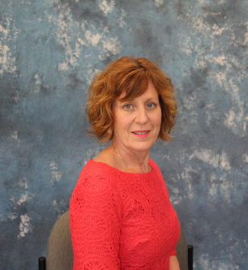


Hi, I’m Donna Murphy, and I am proud to again be the Campaign Director for the 2024 Gloucester County Public Employees Charitable Campaign (GCPECC).
The GCPECC is underway once more raising funds for charitable organizations – local, national, and international.
We make a living by what we get, but we
make a life by what we give.
- Winston Churchill
Donna Murphy
Campaign Director
donnamurphy@uwgcnj.org
Thanks for all that you do!

Slide 3
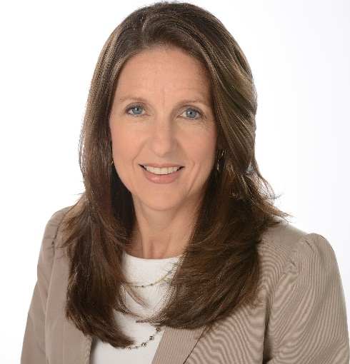
I am honored to work with Commissioner Denice DiCarlo this year, who serves as the Chair for the Gloucester County Public Employees Charitable Campaign (GCPECC).
For Campaign 2023, the GCPECC raised $72,094 for the numerous charities that help our communities grow stronger and more resilient. We hope that for Campaign 2024, giving levels will be even better so that many more charities will benefit from your generosity.
Thank you for your support that is essential to so many. Let’s join together to build better lives in Gloucester County!

Slide 4
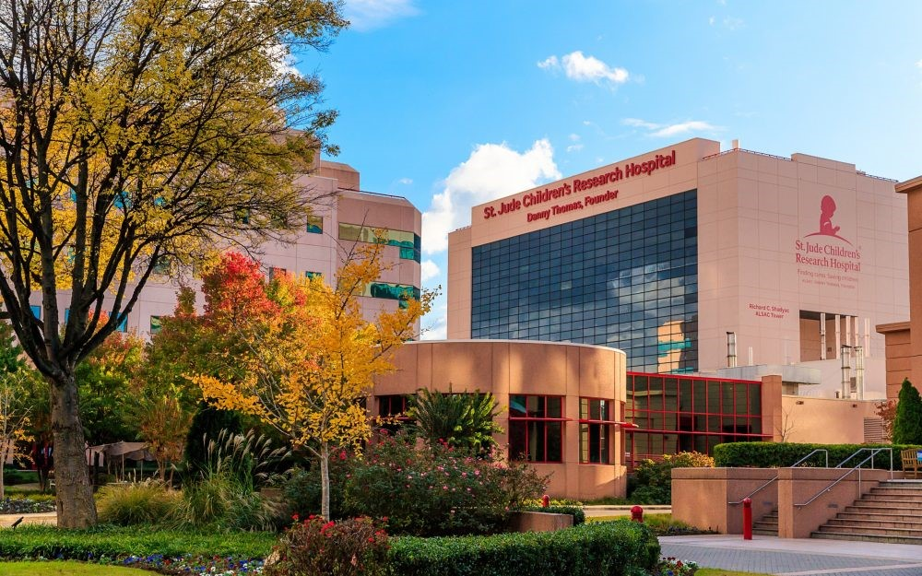

What is the GCPECC?
In 1985, the NJ State Legislature enacted a law providing NJ State and Local Public Employees the opportunity to contribute to a multitude of charities through the convenience of payroll deductions.
The GCPECC is the only fundraising campaign authorized to solicit charitable contributions in the local public employee workplace.
The GCPECC is comprised of charitable organizations that apply to participate.
The GCPECC is NOT a United Way Campaign – United Way has been elected to manage the GCPECC campaign.
No state or local money is used to run the campaign.
Employees can give through their workplace giving campaign each year between September and December.

Slide 5


There are 7 Federations and various other local charities.
There are 487 charities included in the GCPECC brochure for this year!
There are 3 types of public employees that participate – County, Municipal, and Public Education.
Administrative costs for the campaign are 10%.
Contributions can only be designated to the organizations participating in the GCPECC as listed in the brochure.
Donors must contribute at least $52 for each agency they wish to designate.
Acknowledgement of the gift is sent to the contributor directly from the organization to which the contribution is made.

Slide 6
Why have a workplace campaign?
Although many of us would like to help others, giving a substantial amount all at once is not always feasible.
Spreading your donation out over 20, 22, 24, or 26 pay periods (depending on your pay frequency) allows you to make a larger gift without ruining your budget. For example, $5.00 per pay x 26 pay periods equals a $130.00 annual gift…a little at a time adds up to so much!
The minimum donation for each designated gift is $52.00.
Each charity that participates in the campaign undergoes a rigorous screening process.
Only charities that meet the requirements specified by the campaign regulations are approved to participate.

Slide 7

Why give? Where do my contributions go?
Many of you may personally know someone who has been affected by concerns such as health issues, mental health issues, unemployment, inability to pay utility bills, those in need of rental assistance, or other problems
Public employees have a proven record of providing support …many of you are in the front lines of those most in need
YOU have the opportunity to be part of the solution
YOU can create change – choose a cause close to your heart
YOU can rescue an animal, enrich a child’s life, help end suffering, assist a veteran, combat an illness, keep someone warm, support a wildlife habitat, or provide someone with shelter
YOU can designate your gift to any of the participating charities found in the GCPECC brochure

Slide 8


What are the benefits of participation?
When you contribute through the GCPECC campaign, you can be confident that:
Your tax deductible gift goes SPECIFICALLY to the charity you designate – in other words, it goes to the charity you choose to receive your gift and nowhere else
Donating via payroll deduction minimizes administrative costs to charities while maximizing your contribution (10% administrative cost)
You can manage your own philanthropy – you know when deductions start and that you can end them at any time
You can designate to as many charities participating in the GCPECC campaign as you wish, bearing in mind that each designation must be at least $52
Giving is cost-effective and effortless!

Slide 9


GOALS FOR 2024
ASK people to please give – it is typical for people to avoid making a commitment unless they are specifically ASKED and are given enough information to make their decision – the #1 reason people do not give is because they were not asked
INCREASE PARTICIPATION – determine ways to reach out to all employees
INCREASE THE CAMPAIGN’S AWARENESS – share information about all the different charities participating
INCREASE VISIBILITY – consider email blasts and posters advertising the campaign
Consider New Hire enrollment program

Slide 10
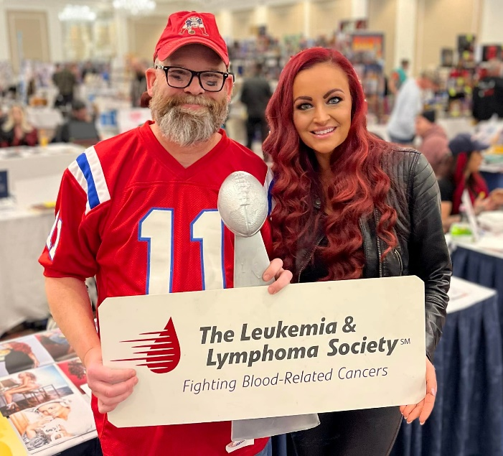

The Employee Campaign Manager (ECM) is Responsible for:
Organizing/Planning the campaign
Coordination of the campaign
Management of GCPECC activities
Liaison to the County Representative / United Way Representative

Slide 11


Important First Steps
Important First Steps
  Attend ECM Training, typically held every September in the UW office
  Review last year’s campaign – what worked and what you would do differently
  Establish support from top management
  Recruit a team eager to help you
  Plan for a “campaign window”…how long will your campaign last?
  Develop a fun and exciting plan that includes a campaign kickoff, incentives or other activities

Slide 12

A Checklist for a Fun and Successful Campaign

Slide 13


ECM Checklist
1. Ask a couple of your coworkers to assist you…this will be your “team”!
2. Ask senior management if they would publicly support the campaign via email blasts, or thanking those who
pledged via email or text.
3. Review the prior year’s campaign performance & calculate a winning strategy.
4. Be the “face” of the GCPECC…hand deliver brochures to your coworkers, put up posters in your workplace
announcing the campaign (posters & other materials can be found at uwgcnj.org/campaign-toolkit/ )
5. Go! Direct the campaign by: Personalizing pledge forms with employee names, if possible; Schedule dates
for the campaign to begin and end; Ask Donna Murphy (856-845-4303 x180) to schedule a guest speaker for
your kickoff date; and Distribute GCPECC brochures and pledge forms to all employees
6. Report campaign results to the County Representative and to Donna Murphy (see “Wrapping Up the
Campaign”)
7. Send a district-wide email announcement with final campaign results to all who pledged to support
the campaign, and thank everyone, including donors, committee members, and helpers, for participating.

Slide 14

During the Campaign
Emphasize payroll deduction as the preferred method of giving…it’s the most cost-effective and easiest way to pledge.
“Asks” are more effective if done in person rather than sending an “ask” in an email or leaving a pile of pledge forms in a common area…these are typically ignored. Instead, speak about the campaign at staff meetings either live or virtual, and hand pledge forms to your coworkers personally.
Promote and inform! Many people do not realize that pledging just $3.00 per week (less than the cost of a cup of coffee) becomes $156.00 given per year! Make sure all your coworkers know this.
Create awareness of the campaign using posters, fliers, and email blasts.
Share your campaign results, events, and photos throughout your workplace.
Track and report results to Donna Murphy, GCPECC Campaign manager at 856-845-4303 x180

Slide 15
Wrapping up the Campaign
Make a final request via email for all employees to fill out their pledge forms & turn them in.
Ensure the pledge forms are filled out completely, signed, and that the math is accurate…say THANK YOU to all those who pledge!
Collect pledge forms and any cash or checks (most pledges will be payroll deduction), total all the proceeds, collect Thanks for Giving tickets, put everything in an Employee Campaign Envelope, and give to GCPECC Campaign Director, Donna Murphy.
Develop a formal thank you plan for all volunteers and donors…an email blast along with an invitation to donuts or homemade cookies in the breakroom is one idea.

Slide 16
And the most important
“Best Practice” of all….
SAY “THANK YOU”!
Send a personal thank you to your campaign team and organization.
Have your department head/principal/mayor send an organization-wide thank you.
Generosity should be rewarded with sincere gratitude

Slide 17
Some Ideas for Thanking Donors, Committee Members, and All Those Who Helped With the Campaign
Place Thank-You posters throughout facility (available from UWGC and can be found on our website www.uwgcnj.org/campaign-toolkit/ …please email lcheeseman@uwgcnj.org if you would like your posters to be personalized with your organization, department, etc.)
Publish a special Thank-You edition of Employee Newsletter.
Send Thank-You emails or text messages.
Always publicize winners of raffles, prizes, competitions, etc.

Slide 18
2024 GCPECC Brochure, Part 1

Slide 19
2024 GCPECC Brochure, Part 2

Slide 20
2024 Gloucester County Public Employees
Charitable Campaign Roster of Charities

Slide 21
2024 United Way of Gloucester County Brochure

Slide 22
Thanks for Giving Raffle Form

Slide 26
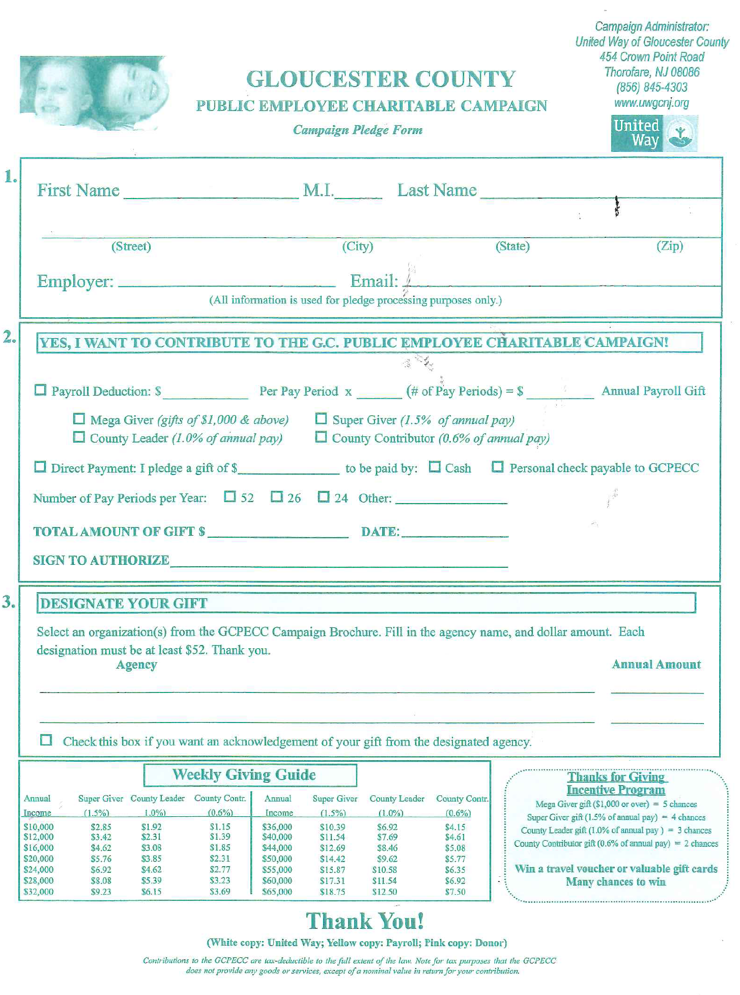
Campaign Envelope Pledge Form
The GCPECC Pledge Form is in 3 parts: the WHITE page goes to UWGC, the YELLOW page goes to the donor’s payroll department, and the PINK page goes to the donor for tax purposes.
NOTE: No Donor Choice form is to be used with Public Employee accounts. Th donor fills in designatedagency name(s) on the bottom of this form.

Slide 27
2024 Because of Your Gift…

Slide 28
2024 YOUR donation of…

Slide 29
2024 Testimonials

Slide 30
2024 Testimonials, cont’d.

Slide 31

Campaign Posters & Visual Aids
Many more items can be found at https://uwgcnj.org/campaign-toolkit/

Slide 32
THANK YOU!
For giving!
For your support and enthusiasm!
For inspiring others!

