Slide 1


United Way Campaign 2026
Best Practices

Slide 2


What is United Way?
United Way of Gloucester County was founded in 1957…we are beginning our 69th year of helping Gloucester County residents in need!
Comprised of 22 partner agencies whose programs cover the impact areas of health, education, and financial stability, and beginning this year, we are announcing our newest initiative…United For Children… whereby we are endeavoring to lift 30 families out of poverty in 3 select areas (Woodbury, Glassboro, and Paulsboro), and to do this by 2030.
Programs are reviewed and outcomes are measured by a volunteer committee to ensure the greatest impact.
This volunteer committee consists of people from all walks of life in the community brought together by UWGC to collaborate and develop plans for each impact area.
Over $94.6 million has been raised for our partner agencies and designated charitable agencies (per our donors’ wishes) since 1957.

Slide 3

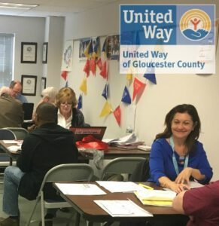

PROGRAMS
Women United
National program of United Way Worldwide, organized in 2008 locally to provide women in Gloucester County the opportunity to assist others in reaching their fullest potential and
empowering women of all ages
Has funded 45 grants for over $103,000.
NJ211
24/7 statewide information and referral hotline
Helps to identify and connect individuals with providers of needed assistance
Searchable database of services is available at www.nj211.org
AARP Tax Aid
Free tax assistance program for low, moderate and fixed income households
Since inception in 2009, the program has saved Gloucester County residents nearly $7,000,000 in filing fees

Slide 4
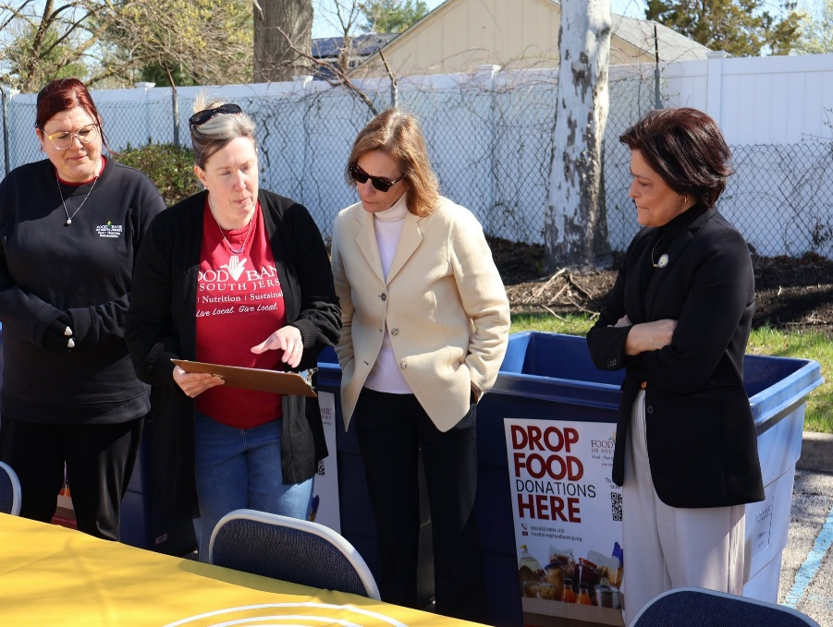
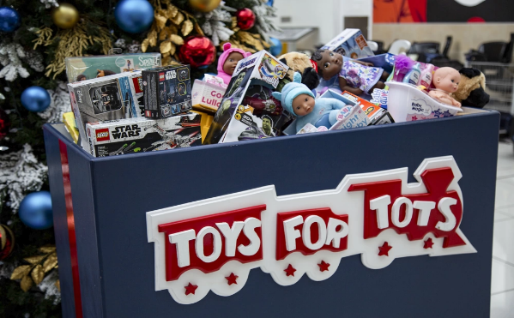

Drives
Gloucester County Cares About Hunger
The 21st Annual Drive was held on April 6, 2026.
15 organizations participated…together we collected over 3,000 pounds of food (equals 3,000 meals)!
Since 2006, over 252,000 pounds of food have been collected to feed hungry Gloucester County families.
Co-sponsored by the United Way of Gloucester County and the Gloucester County Board of Commissioners - Human Service Advisory Council
Toys for Tots
Over 30 organizations participated, serving nearly 60,000 Gloucester County children during the 2025 holiday season
Operated in conjunction with Semper Fidelis Detachment of Marine Corps League

Slide 5
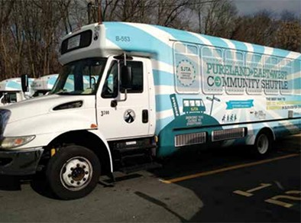

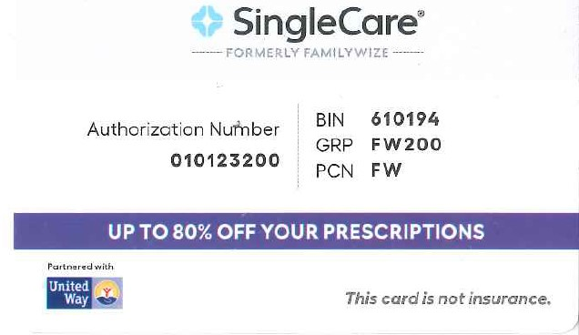
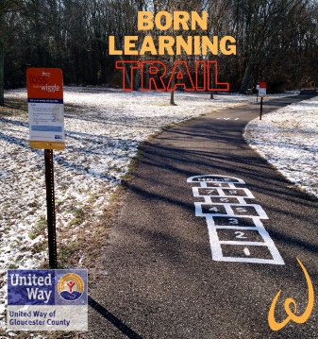
A Checklist for a Great Campaign
Initiatives
SingleCare Prescription Program (formerly FamilyWize)
Free prescription drug savings card used by uninsured and underinsured
Acceptable at all national stores where prescriptions are filled
Over 20,000 Gloucester County residents saved nearly $3,000,000 since this program was launched
Pureland East-West Community Shuttle
Free, easy access transportation along the Route 322 corridor to Pureland Industrial Park with internal Pureland shuttle
Connects with ten NJT bus routes
Cost of the Pureland East-West Shuttle and the Internal Circulator is free.
Since the program’s inception in 2015, total ridership is nearly 400,000
Born Learning Trail
Interactive trail designed to boost school readiness
Eight trails in Gloucester County ~ Clayton, Woodbury, Mullica Hill, West Deptford, Swedesboro, Woolwich Township, Logan Township, and Glassboro

Slide 6
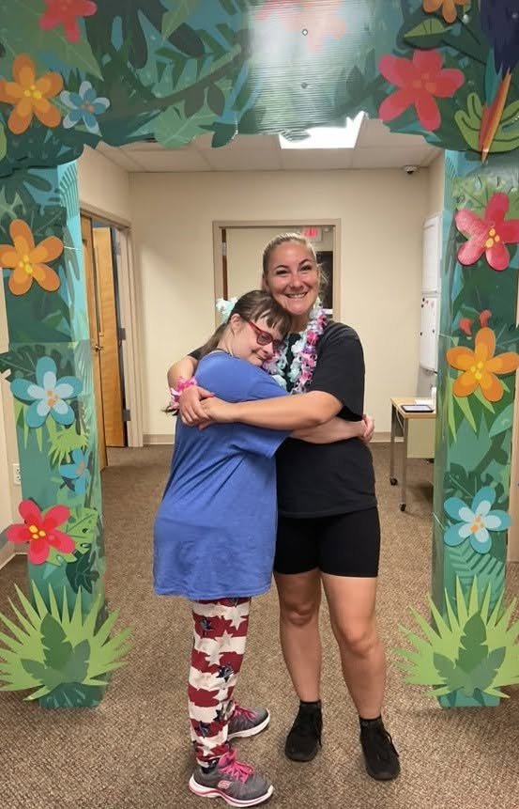
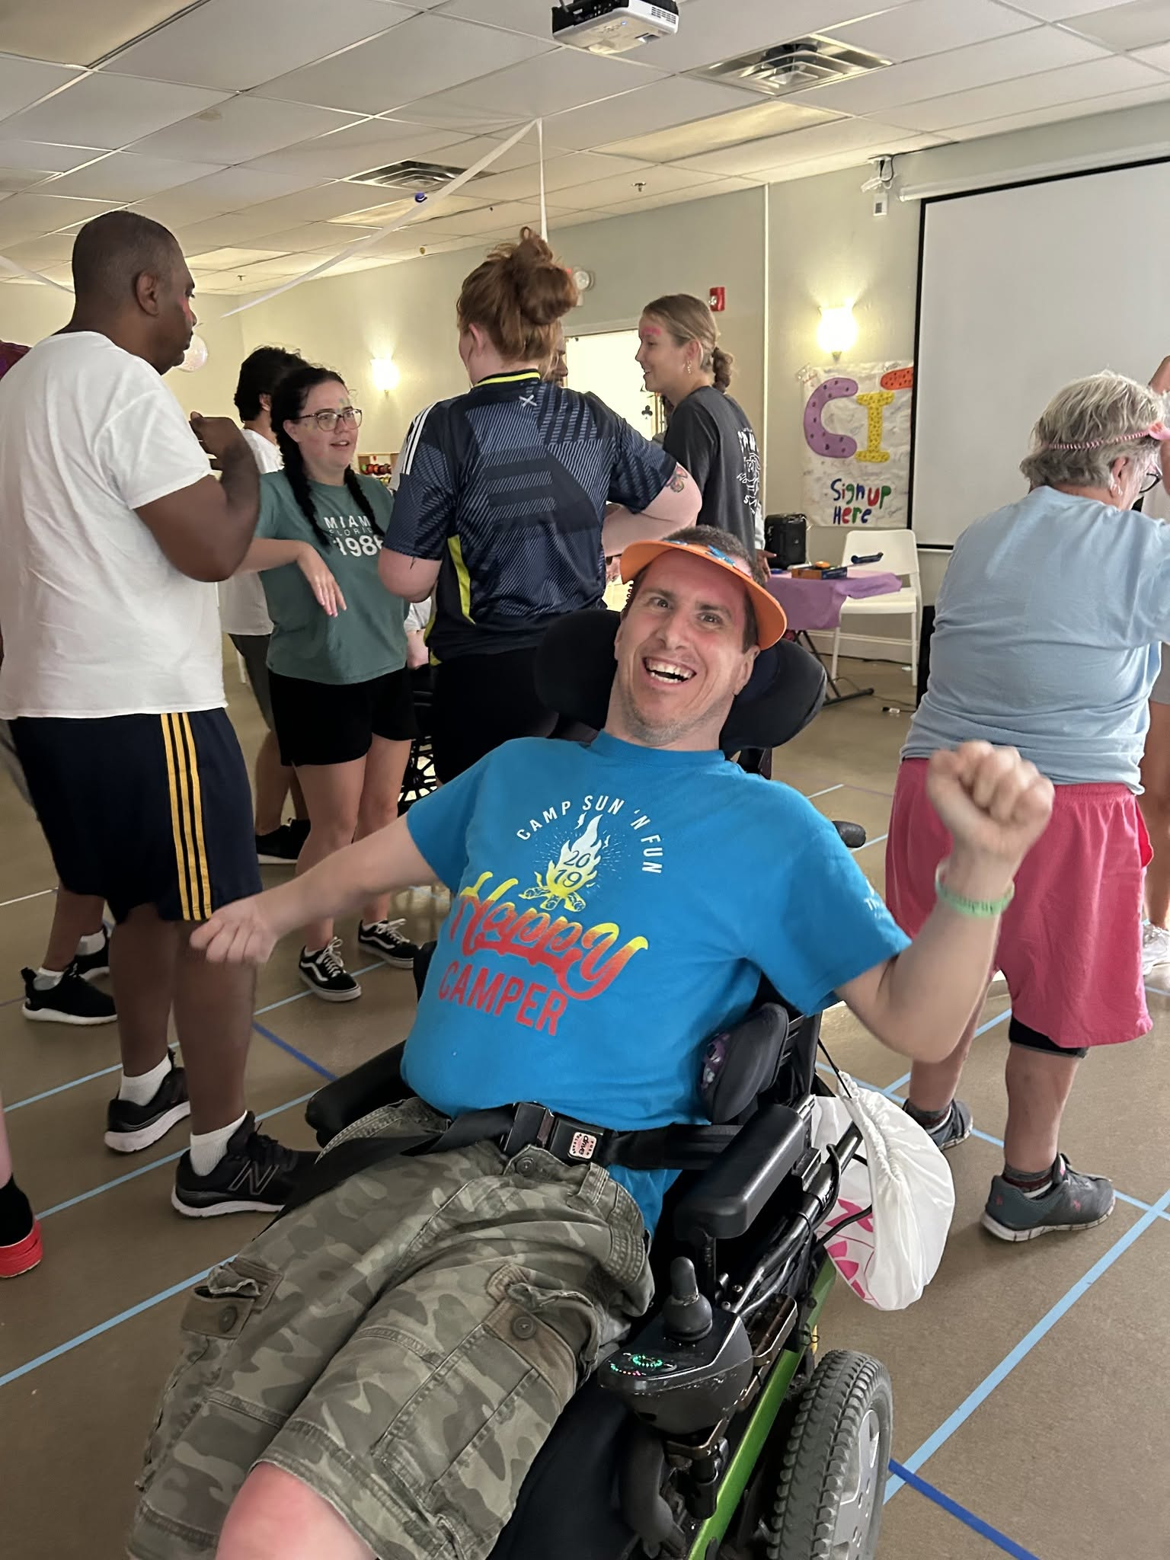



Why have a workplace campaign?
Although many of us would like to help others, giving a substantial amount all at once is not always possible.
Spreading your donation out over 20, 22, 24, or 26 pay periods (depending on your pay frequency) allows you to make a larger gift without ruining your budget. For example, $5.00 per pay x 26 pay periods equals a $130.00 annual gift…a little at a time adds up to so much!
You can designate your gift to any charity that is a certified and registered 501(c)(3) charitable organization.
The minimum donation for each designated gift is $26.00.

Slide 7


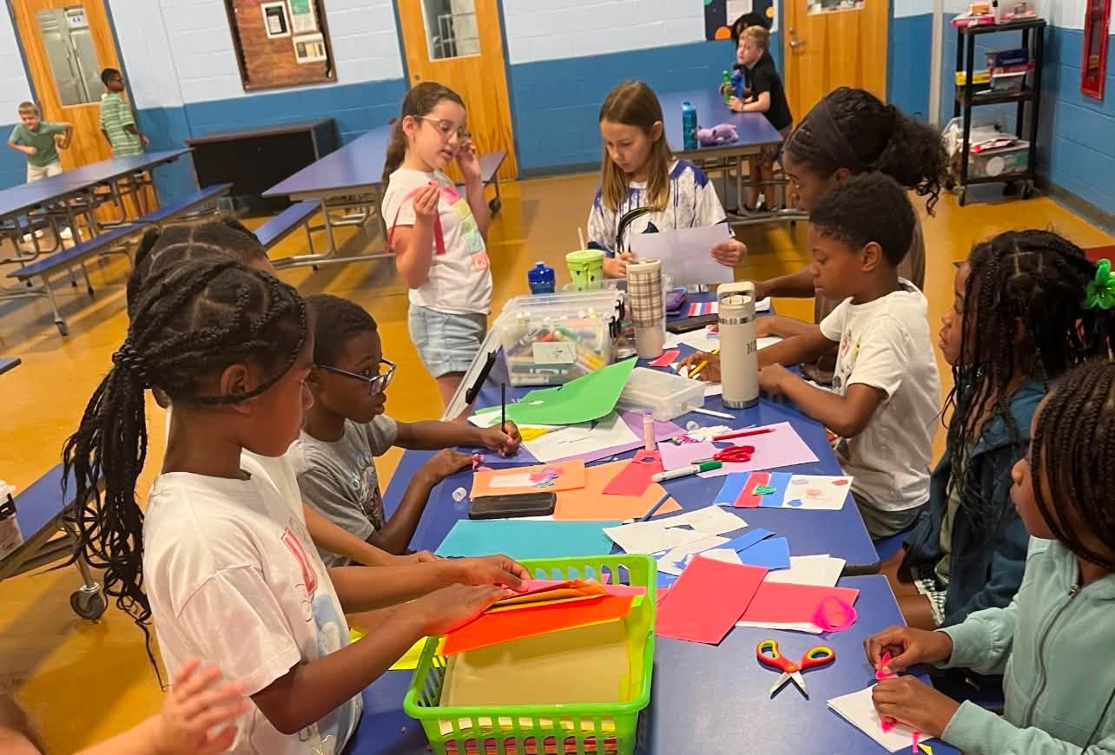

Why give? Where do my contributions go?
If you do not designate your gift, it is allocated to 9 local programs within Gloucester County, overseen by our 22 partner agencies. One gift helps many!
If you do desire to designate your gift, you may choose any of our Gloucester County partner agencies, or any charity within the United States, providing it is a certified 501(c)(3) registered charitable organization.
YOU can be part of the solution.
YOU have the opportunity to enrich a child’s life, feed a hungry family, assist a veteran, combat an illness, keep someone warm, support a wildlife habitat, rescue an animal, or provide someone with shelter.
THANK YOU for choosing to give!

Slide 8
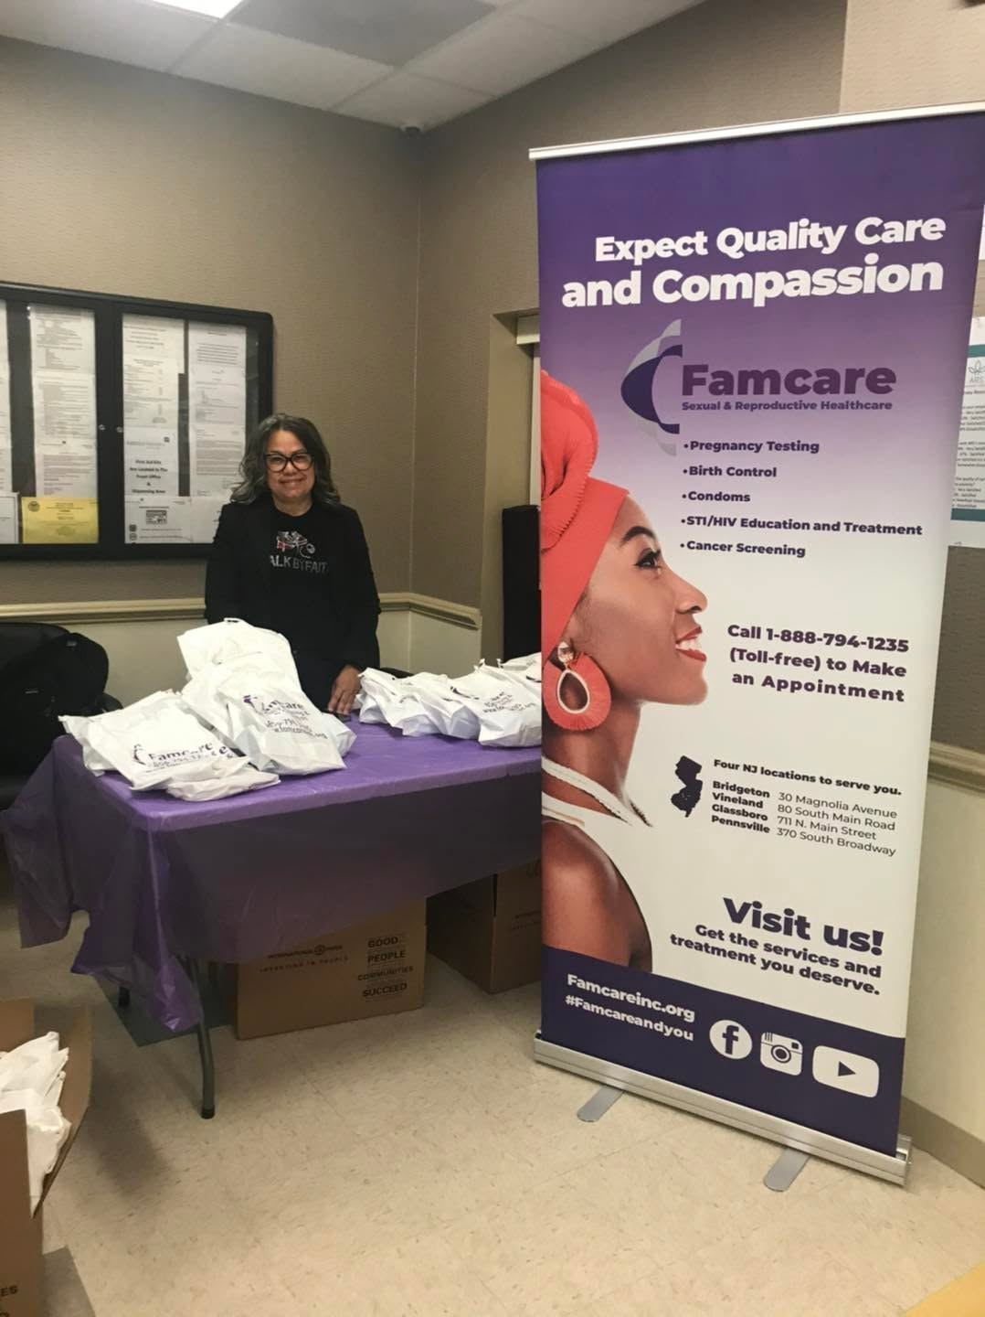
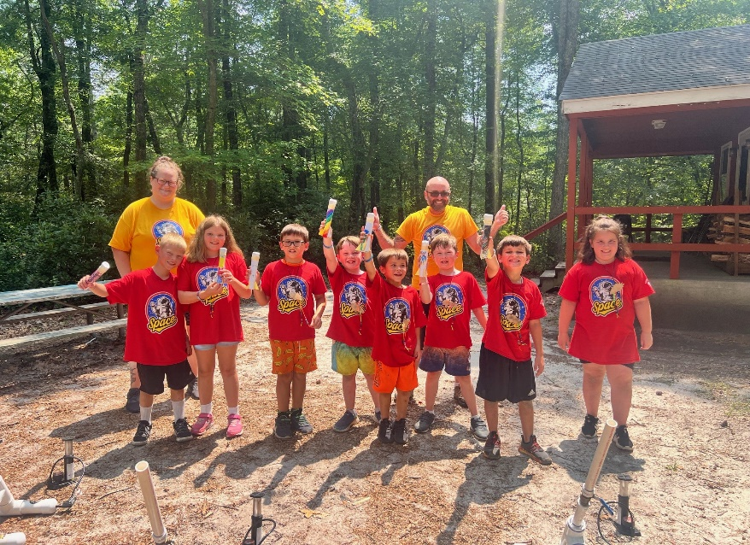

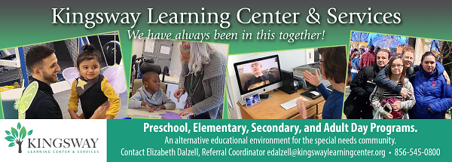

What are the benefits of participation?
When you contribute to the United Way campaign, you can be confident that:
Donating via payroll deduction minimizes administrative costs while maximizing your contribution (12.7% administrative cost)
With payroll deduction, you can manage your own philanthropy – you know when deductions start and that you can end them at any time
You can designate to as many charities as you wish, bearing in mind that each designation must be at least $26
Giving is cost-effective and effortless!

Slide 9
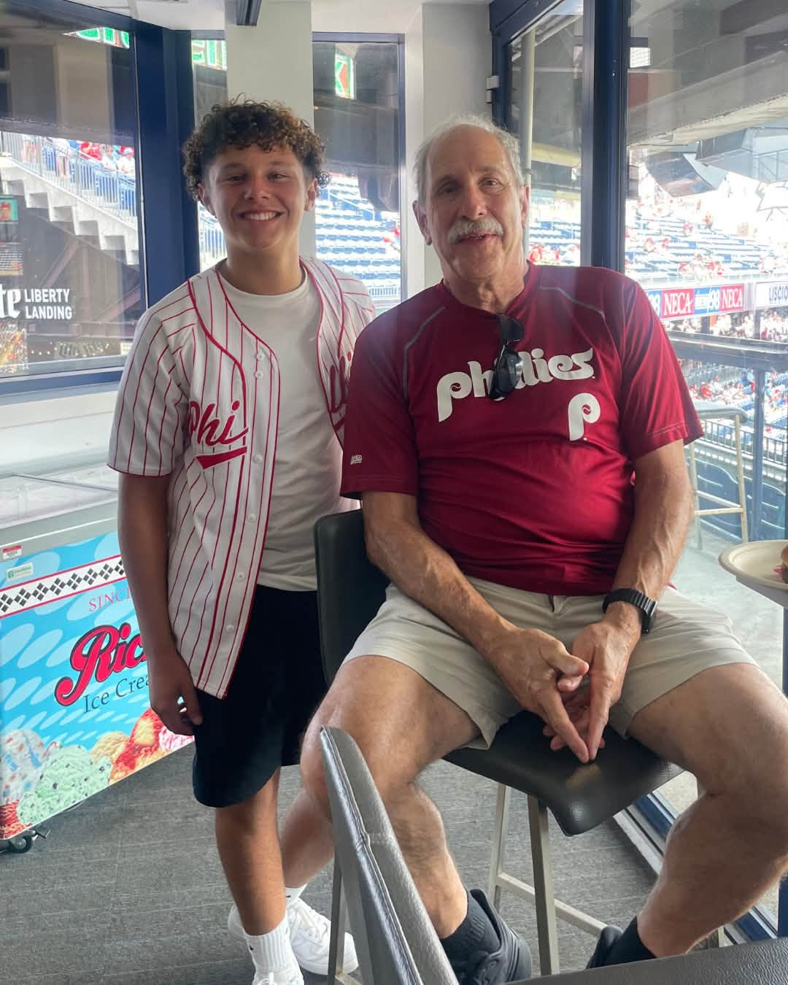

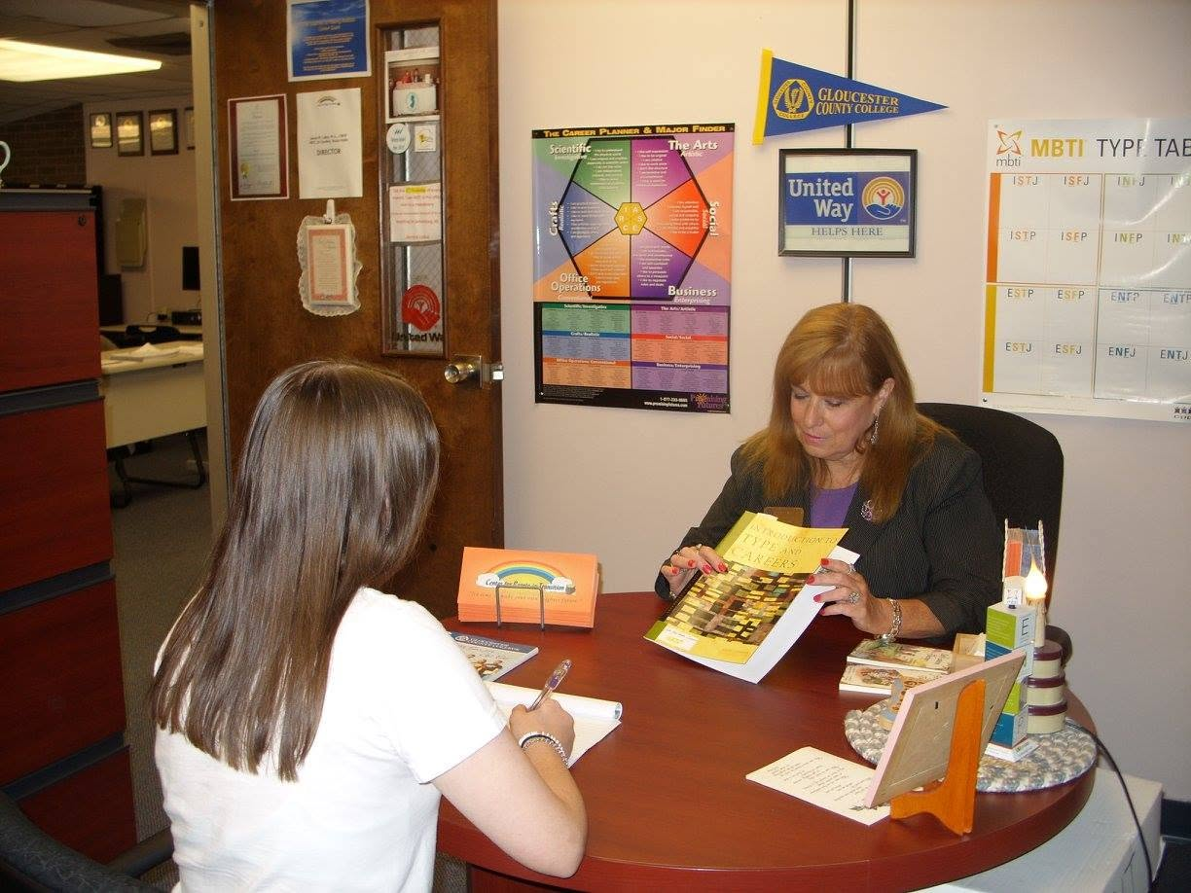


What are our goals for 2026?
ASK YOUR COWORKERS TO GIVE – it is typical for people to avoid making a commitment unless they are specifically ASKED and are given enough information to make their decision – the #1 reason people do not give is because they were not asked. Suggest that they visit our online Campaign Toolkit which can be found at https://uwgcnj.org/campaign-toolkit/ where there is a wealth of information at their fingertips about what we do!
INCREASE PARTICIPATION – determine ways to reach out to all employees
INCREASE THE CAMPAIGN’S AWARENESS BY INCREASING VISIBILITY – share information about the campaign via posters throughout your workplace (contact us for more info about this!), email blasts, texts, and by holding employee group meetings, when possible

Slide 10
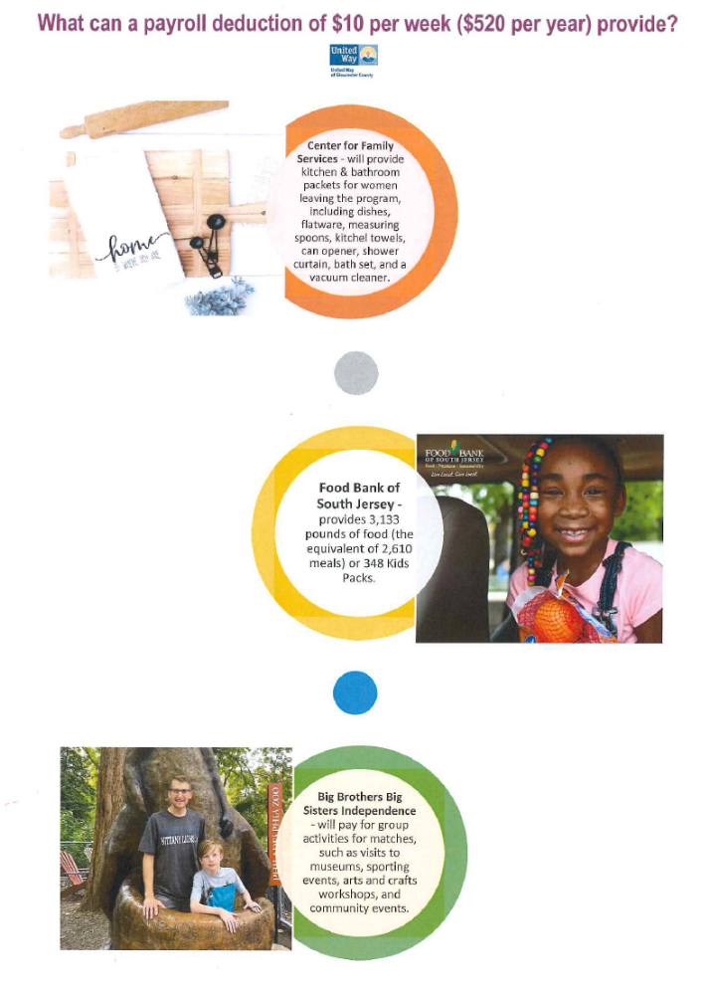

Important First Steps
Review this booklet…we are always here to answer any questions; see contact info below. Running a campaign is stress-free, doesn’t take a lot of effort, is fun and rewarding, and gives you a great sense of accomplishment knowing that you led the push to motivate your coworkers to give back to their communities.
Review your company’s Giving History– what worked and what you might want to do differently
Seek campaign support from top management
There’s fun in numbers! Recruit a coworker or two who are eager to help
Plan for how long your campaign will last…one week? Two?
Develop a fun strategy that includes a short campaign kickoff (maybe during lunchtime!) with some light refreshments, and propose a theme, incentives or other activities
Donna Murphy –
Campaign Director
856.845.4303 x180
donnamurphy@uwgcnj.org

Slide 11


Do you and your coworkers want to help people in your community?
It’s easy! Here’s how…
United Way Campaign 2026

Slide 12
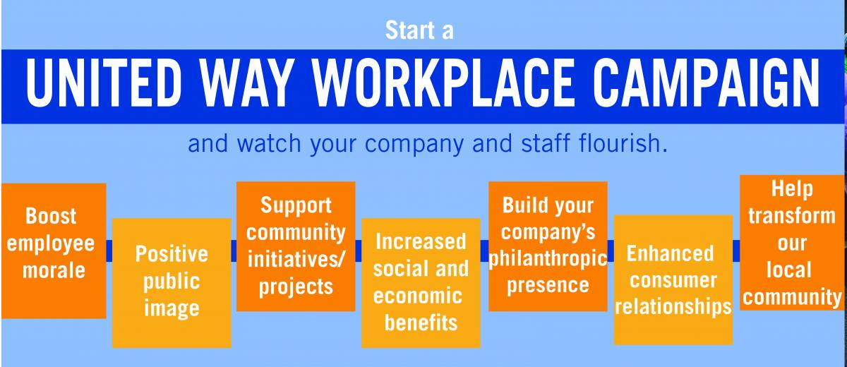
ECM Plan of Action
1. Teamwork! Ask a coworker or two if they would assist you in promoting the campaign.
2. Ask senior management if they would publicly support the campaign via email blasts,
or thanking those who pledged via email or text.
3. Review the prior year’s campaign performance & calculate a winning strategy.
4. Be the “face” of United Way…hand deliver brochures to your coworkers, put
up posters around your workplace announcing the campaign, look on our website at
www.uwgcnj.org/campaign-toolkit/ for motivational posters & other materials!
5. Run the campaign:
  Personalize pledge forms with employee names, if possible
  Schedule dates for the campaign to begin and end
  Ask Donna Murphy, UWGC Campaign Director, to schedule a guest speaker for your kickoff date
  Make sure all employees have received UWGC Brochures and pledge forms
6. Report campaign results to Donna Murphy (see “Wrapping Up the Campaign”)
7. Report final results via email blast, text, or departmental meeting throughout your workplace.
8. Don’t forget to say THANK YOU to all donors, and those who helped with the campaign!

Slide 13

Things to do during the Campaign…
Emphasize payroll deduction as the preferred method of giving…it’s the most cost-effective and easiest way to pledge.
“Asks” are more effective if done in person rather than sending an “ask” in an email or leaving a pile of pledge forms in a common area…these are typically ignored. Instead, speak about the campaign at staff meetings either live or virtual, and hand pledge forms to your coworkers personally.
Promote and educate! Many people do not realize that pledging just $3.00 per week (the price of a cup of coffee!) becomes $156.00 given per year! Make sure all your coworkers know this.
Create awareness of the campaign using posters, fliers, and email blasts…check out our campaign toolkit for posters, fliers, and other materials https://uwgcnj.org/campaign-toolkit/ .
Share your campaign results throughout your workplace.
Track and report results!

Slide 14

Wrapping up the Campaign
Make a final request via email for all employees to fill out their pledge forms.
Ensure that pledge forms are filled out completely, signed, and that the math is accurate…say THANK YOU to all those who pledge!
Collect pledge forms and any cash or checks (most pledges will be payroll deduction), total all the proceeds and put everything in an Employee Campaign Envelope (provided for you), and give to your UWGC Ambassador or call Campaign Director Donna Murphy to let her know that it’s ready for pick up (856.845.4303 x180).
Develop a thank you plan for all volunteers and donors…an email blast along with an invitation to donuts in the breakroom is one idea.

Slide 15

And the most important “Best Practice” of all….SAY “THANK YOU”!
Send a personal thank you to your campaign team & management.
Place Thank-You posters throughout facility (available from UWGC and can be found on our website www.uwgcnj.org/campaign-toolkit/ …please email lcheeseman@uwgcnj.org for more info – all posters can be personalized)
Publish a special Thank-You edition of Employee Newsletter.
Send Thank-You emails or text messages.
Always publicize winners of raffles, prizes, competitions, etc.

Slide 16
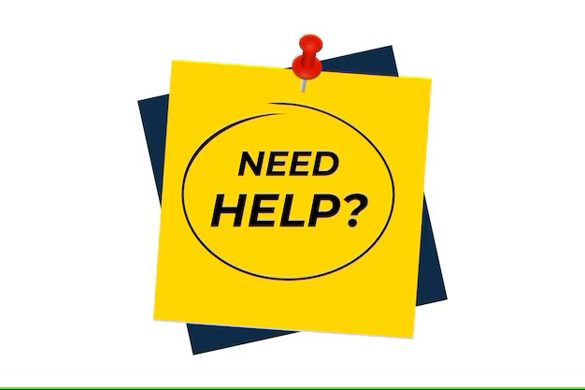

Many of our supporters have asked for more information concerning how their donations are spent supporting various programs at our partner agencies.
We heard you! On the following pages you will find examples of helpful and educational campaign materials for you to use as you run your campaign, all submitted by our partner agencies. All these and much more can be found on our website at www.uwgcnj.org/campaign-toolkit/

Slide 17
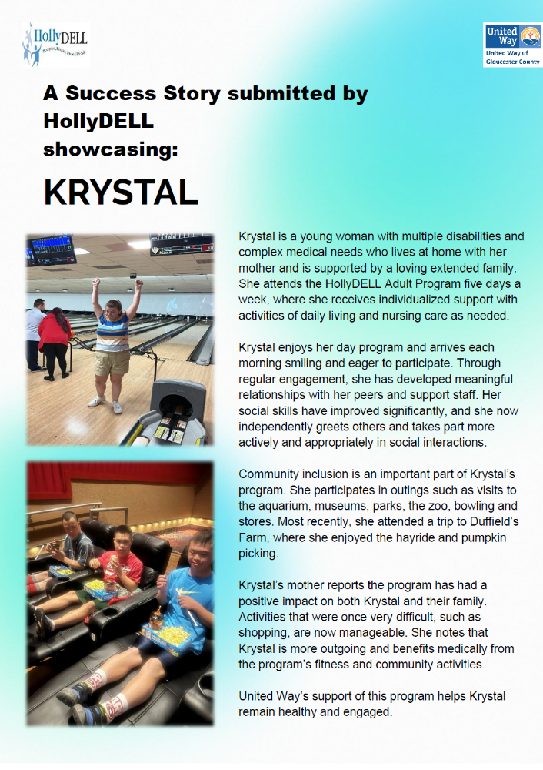
SUCCESS STORIES…
These are submitted by our partner agencies on their applications to UWGC for funds to support a specific program. This one was submitted by HollyDell in support of their Adult Community Inclusion Program.

Slide 18
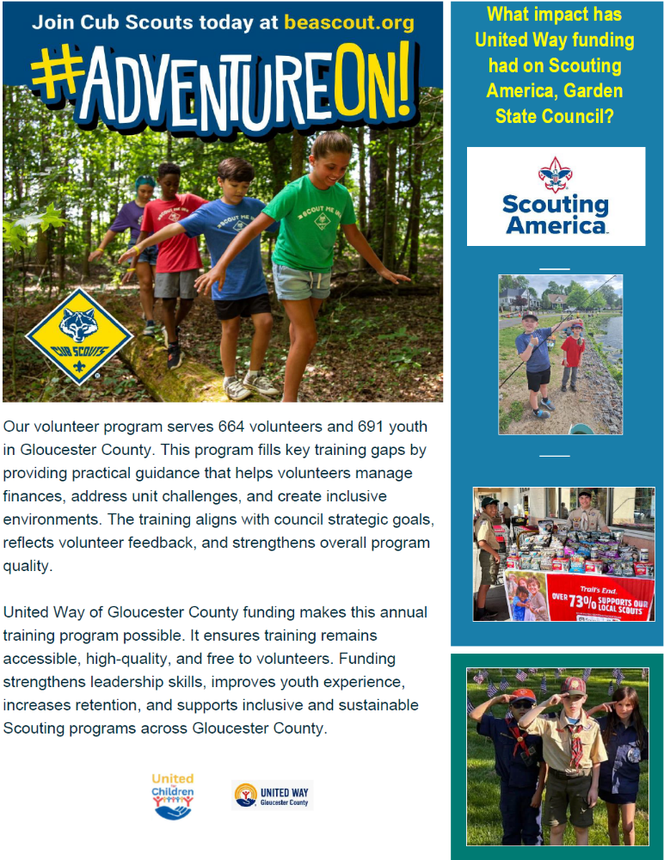
IMPACT STATEMENTS…
Partner agencies requesting funding from UWGC are asked to state how this funding will impact specific programs. This statement is from Scouting America.

Slide 19

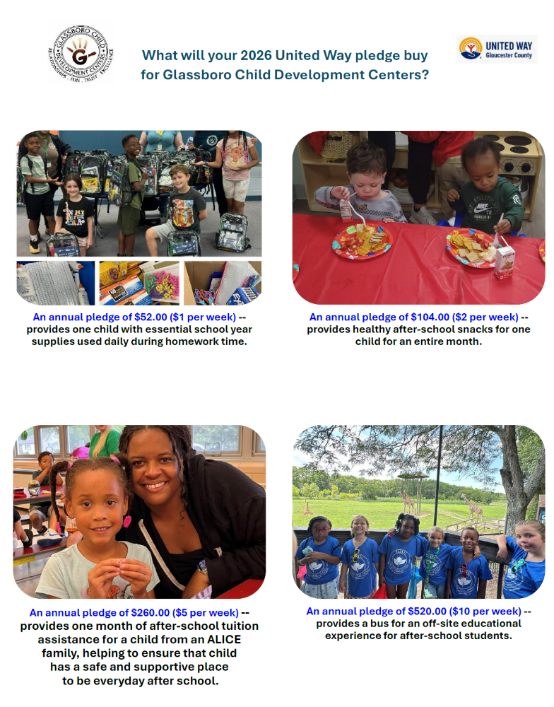
WHAT WILL YOUR PLEDGE PURCHASE?
In order to present more detailed information to potential donors, partner agencies are asked by UWGC to state what a specific donation would buy to assist their program. This one was submitted by Glassboro Child Development Centers.

Slide 20

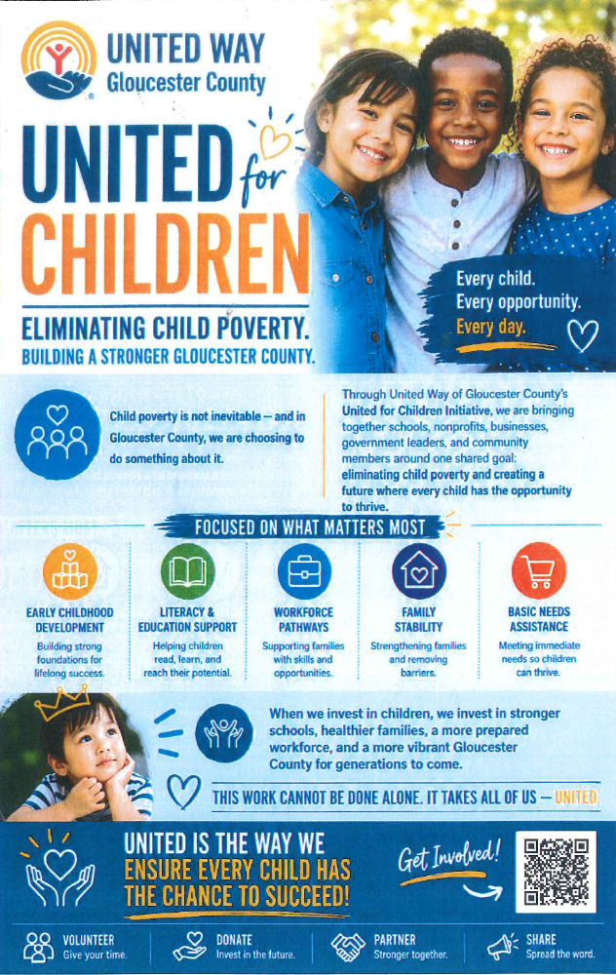

Slide 21
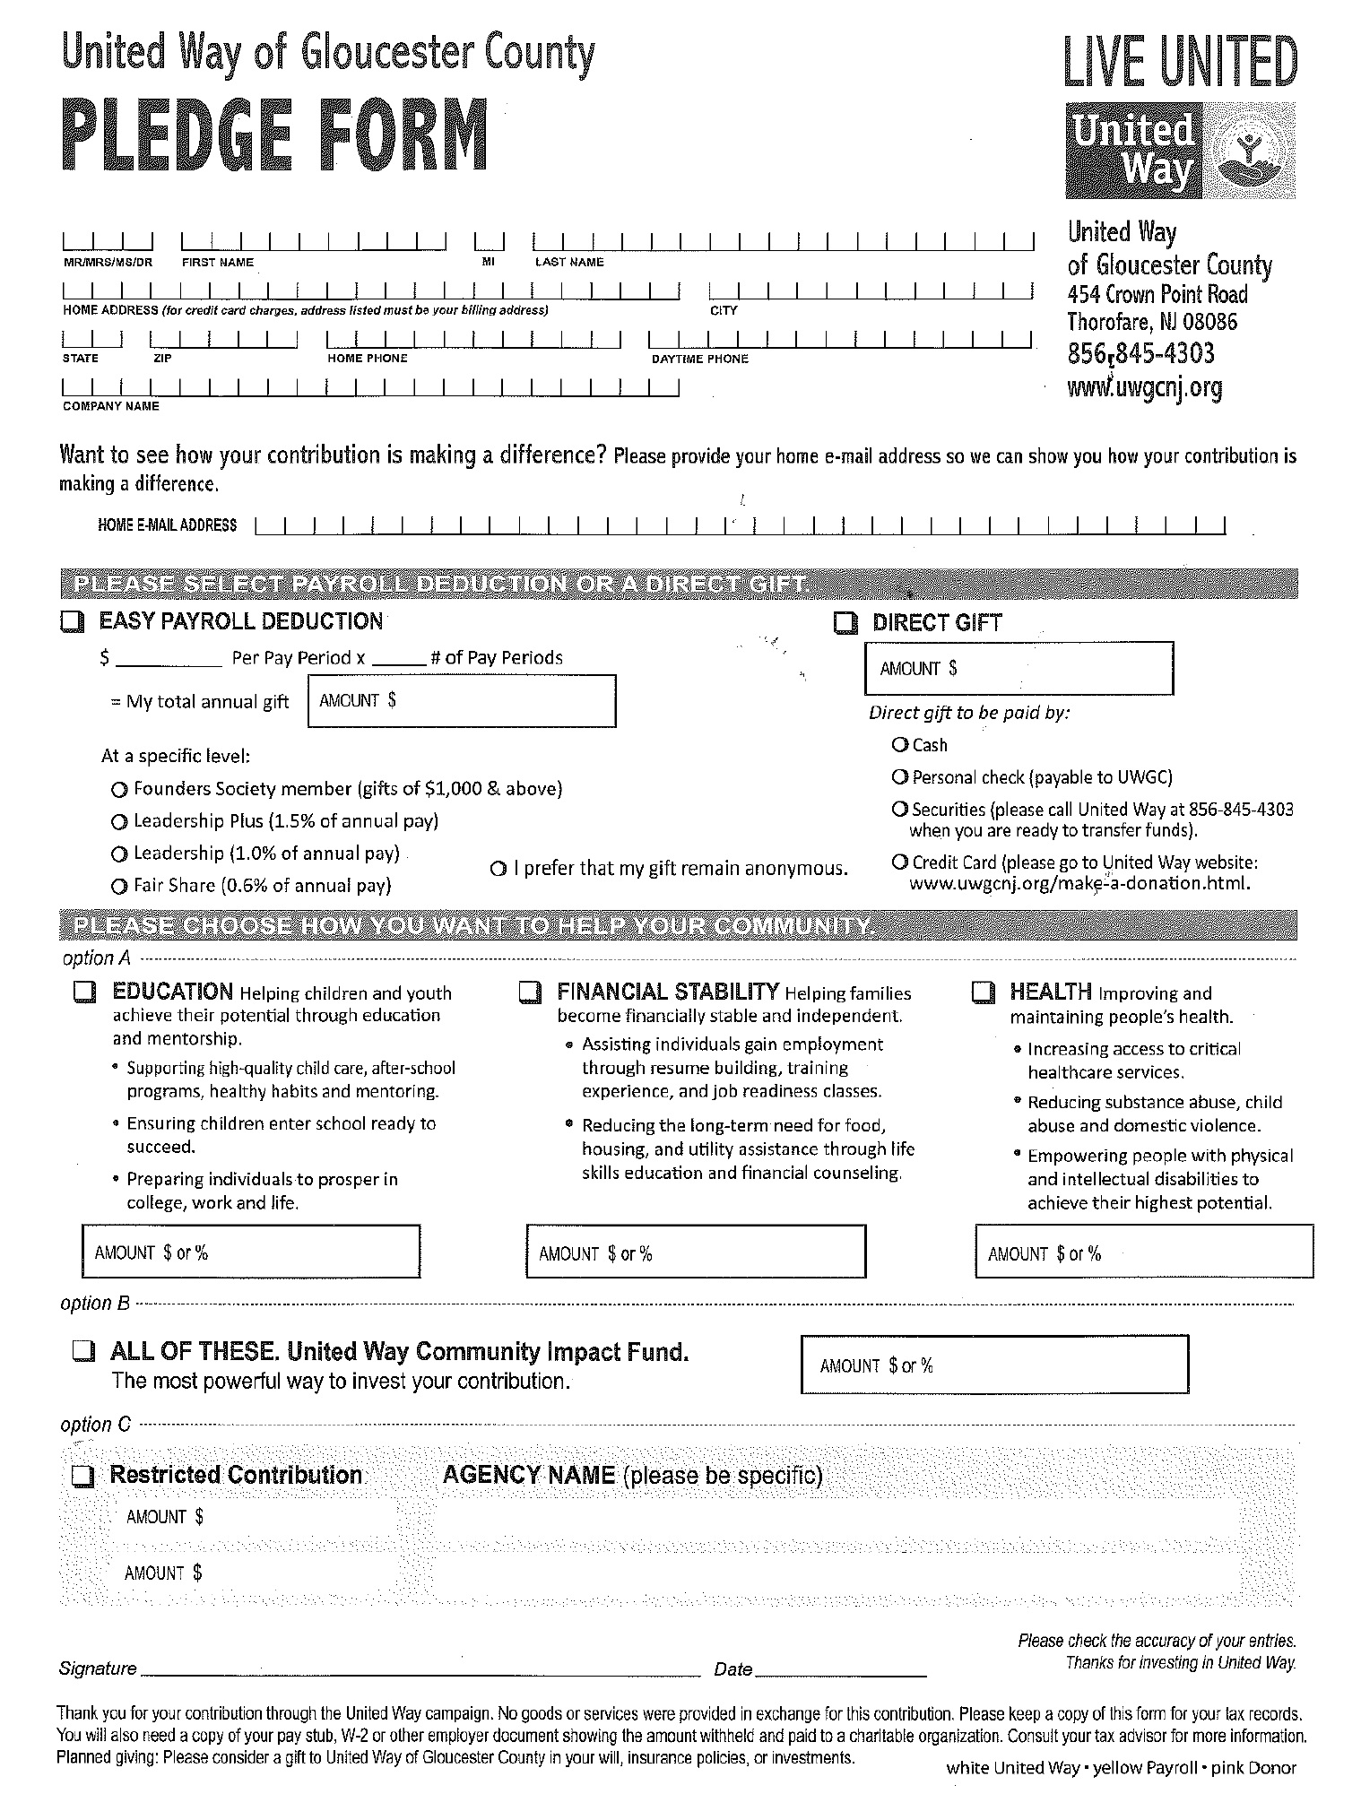
Campaign Pledge Form - Redesigned
(separate donor choice form not necessary with this)
This pledge form is in 3 parts:
* 1st page = white, United Way
copy
* 2nd page = yellow, Payroll copy
* 3rd page = pink, Donor copy
(for tax purposes)
Fill in complete information for name,
address, employer and phone
PLEASE provide email so we may add
you to our monthly newsletter
Determine manner to contribute
Verify pay periods
Compute total annual gift
PLEASE MAKE SURE TO SIGN FORM FOR
PAYROLL DEDUCTIONS
If making a gift via check – PLEASE
make check payable to UWGC
Determine how you want to help

Slide 22
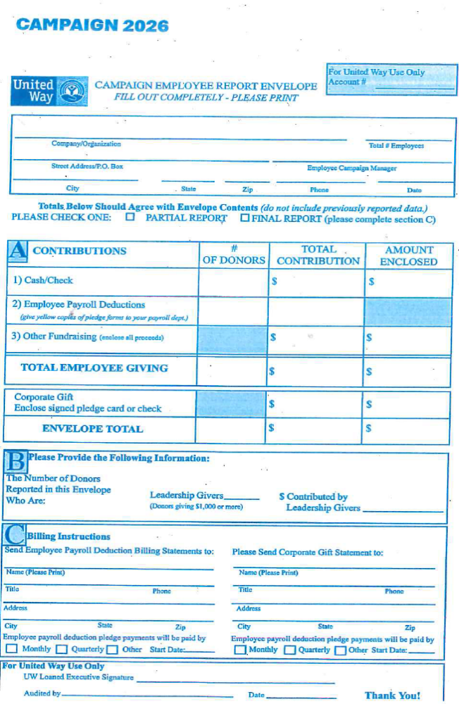
Employee Campaign Report Envelope
(blue lettering – for UW accounts only)
Give
Advocate
Volunteer

Slide 23
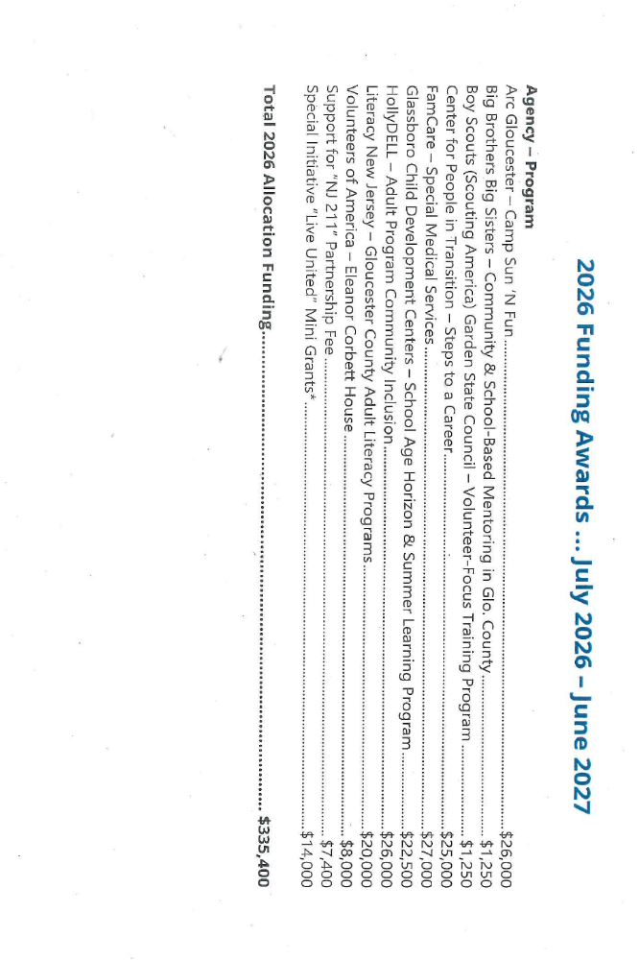
2025 Funding Awards (June 2025 – July 2026)

Slide 24
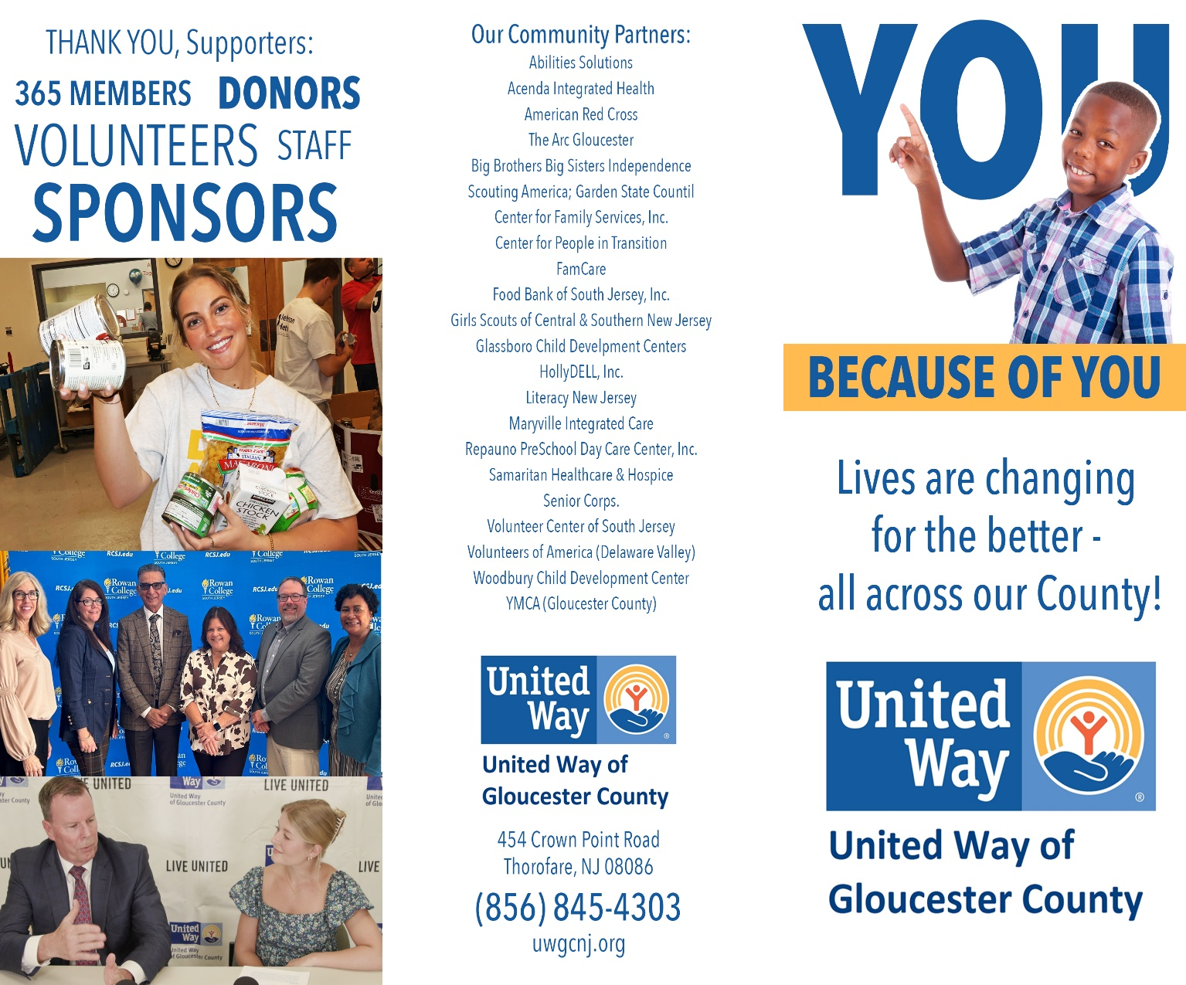
UWGC Brochure front
Ask your UW Ambassador for an adequate supply of these for all of your coworkers, or call Donna Murphy
at 856.845.4303 x180

Slide 25

UWGC Brochure back
Ask your UW Ambassador for an adequate supply of these for all of your coworkers, or call Donna Murphy
at 856.845.4303 x180

Slide 26


THE LIVE UNITED 365 SMALL BUSINESS CIRCLE
For only a dollar a day, or $365 a year, your business becomes
a member of the LIVE UNITED 365 Small Business Circle.
United Way of Gloucester County (UWGC) has created an
easy, affordable, and effective way for companies with
fewer than 35 employees to give back to their community.
Being a 365 Small Business Circle member aligns your
business with the strong LIVE UNITED brand, recognized
as one of the Top 10 most recognizable nonprofit brands
in the world. You will receive an exclusive LIVE UNITED
365 Small Business Circle decal to display and show your
customers your commitment to the community, plus you’ll
receive many other member benefits.
Current Members of the UWGC 365 Small Business Circle
A.M. Botte Mechanical – Plumbing,
Heating & Cooling
The Bank of Princeton
Bellia Print & Design
Best Buds, LLC
BonBon Parties & Events
Botto’s Italian Line Restaurant
Broad & Maple, LLC
Cepha Management
Ciaccia, CPA
Clear Path By Cindy
Columbia Bank
Connolly Family Dentisty
DDS Services, LLC
Edward Jones
Franklin Bank
Fulton Bank
Graham Communications
Heritage’s Dairy Stores
Impressions Unlimited
Jersey Joint Dispensary
Lamb Realty
Mantua Coin-Op Laundromat
Maui Ice
Morris Graphics
Mullica Hill Family Eyecare
Parke Bank
PPLSI / LegalShield
1166 Federal Credit Union
Riggs Creative Group, LLC
Sweetsboro Pastry Shoppe
TD Bank
Telecorp, Inc.
Tim Skabo State Farmy Agency
Tummy Tee, LLC
U.S. Electrical Services
VisionLine Media
VMX Technologies, LLC
Ward, Shindle & Hall, Attorneys at Law
Your CBD Store of Gibbstown

Slide 27
The investment made to UWGC by our 365 Small Business Circle participants provides funding for a number of Mini-Grants of up to $1,000 each for programs and agencies to conduct life-changing work in Gloucester County. Since 2015, this initiative has supported 143 programs and has raised over $160,000 to provide these services to Gloucester County residents. Mini-Grant applications are open starting July 1, 2026 and will remain
open on a rolling basis while funding is available, or until 5/31/2027.
The following organizations received Mini-Grants for Year 2025:
Boys & Girls Clubs of Gloucester County
Emmanuel Cancer Foundation
Greater Woodbury Cooperative Ministries, Inc.
Gloucester County Habitat for Humanity
King’s Things
Lauren Rose Albert Foundation / Mothers Matter
Newfield Terrace Community Action Organization
Partners in Learning
Professional Trainers Advancing Humanity Initiative, Inc.
Rowan College of South Jersey Foundation
SHADOW Equestrian
South Jersey Dream Center
St. Peter’s Community Pantry
The Better Giveback Foundation
Viola’s Place, Inc.
Your Place At The Table (YPATT)
For more information about the 365 Live United Small Business Circle, please contact Donna Murphy at 856-845-4303 x180, or donnamurphy@uwgcnj.org. For a complete description of each program, please visit our website:
https://uwgcnj.org/campaign/small-business-program/

Slide 28



Posters for your campaign!
Here are some examples…more can be found at https://uwgcnj.org/campaign toolkit

Slide 29

THANK YOU!
For giving!
For your support and enthusiasm!
For inspiring others!

