Slide 1
United Way Campaign 2024
Best Practices

Slide 2
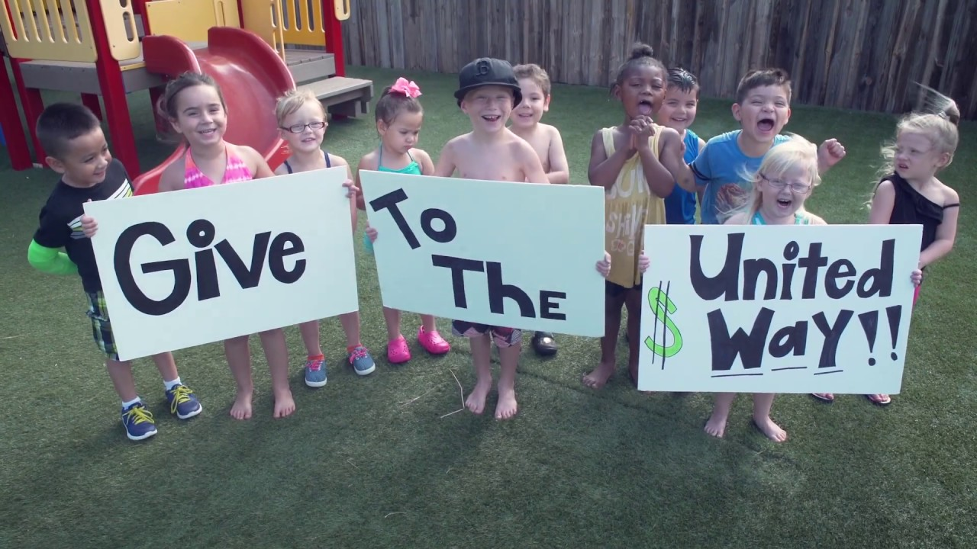
What is United Way?
United Way of Gloucester County was founded in 1957…we are beginning our 67th year of helping Gloucester County residents in need!
Comprised of 22 partner agencies whose programs cover 3 “impact areas”…health, education, and financial stability. One gift helps may, this is the effectiveness of United Way!
Programs are reviewed and outcomes are measured by a volunteer committee to ensure the greatest impact.
This volunteer committee consists of people from all walks of life in the community brought together by UWGC to collaborate and develop plans for each impact area.
Nearly $94 million has been raised for our partner agencies and designated charitable agencies (per our donors’ wishes) since 1957.

Slide 3

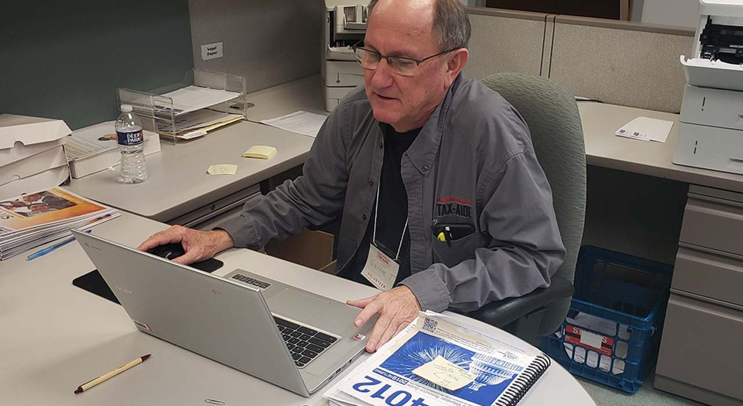
PROGRAMS
Women United
National program of United Way Worldwide, organized in 2008 locally to provide women
in Gloucester County the opportunity to assist others in reaching their fullest potential and
empowering women of all ages
Has funded 39 grants for $97,953.
NJ211
24/7 statewide information and referral hotline
Helps to identify and connect individuals with providers of needed assistance
Searchable database of services is available at www.nj211.org
AARP Tax Aid
Free tax assistance program for low, moderate and fixed income households
Since inception in 2009, the program has saved Gloucester County residents over $5 million in filing fees

Slide 4

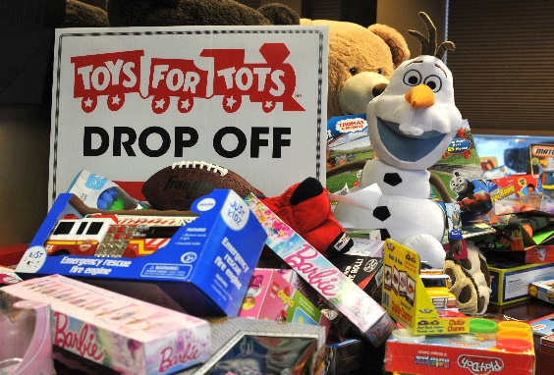


Drives
Gloucester County Cares About Hunger
The 19th Annual drive was held on March 4, 2024
29 organizations participated…together we collected 5,040 pounds of food (equals 6,048 meals)!
Since 2006, over 232,000 pounds of food have been collected to feed hungry Gloucester County families.
Co-sponsored by the United Way of Gloucester County and the Gloucester County Board of Commissioners - Human Service Advisory Council
Toys for Tots
35 organizations collected enough toys to put smiles on the faces of over 55,000 Gloucester County children during the 2023 holiday season
Operated in conjunction with Semper Fidelis Detachment of Marine Corps League
Coat Drive
Held in conjunction with HFM Investment Advisors.
Over 800 coats were collected and distributed to area nonprofits
Over 25,000 coats have been collected since 2010 (no drive held in 2020 due to the pandemic)

Slide 5

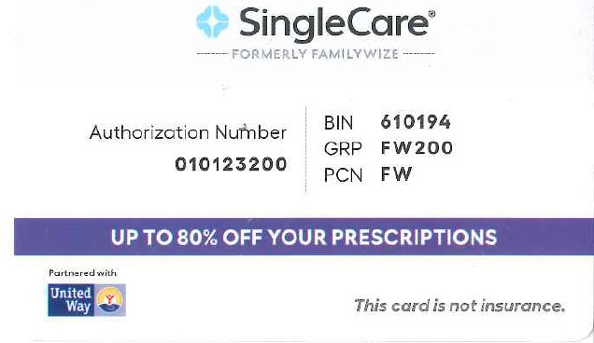
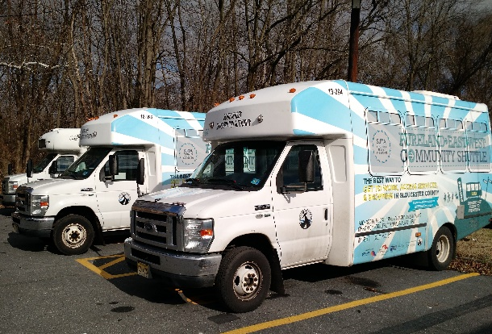
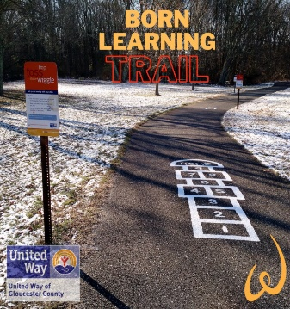
A Checklist for a Great Campaign
Initiatives
SingleCare Prescription Program (formerly FamilyWize)
Free prescription drug savings card used by uninsured and underinsured
Acceptable at all national stores where prescriptions are filled
18,104 Gloucester County residents saved $2,325,394 since this program was launched
Pureland East-West Community Shuttle
Low-cost easy access transportation along the Route 322 corridor to Pureland Industrial Park with internal Pureland shuttle
Connects with ten NJT bus routes
Cost is $1 each way with internal shuttle free
Since the program’s inception in 2015, total ridership is 322,551
Born Learning Trail
Interactive trail designed to boost school readiness
Eight trails in Gloucester County ~ Clayton, Woodbury, Mullica Hill, West Deptford, Swedesboro, Woolwich Township, Logan Township, and Glassboro

Slide 6
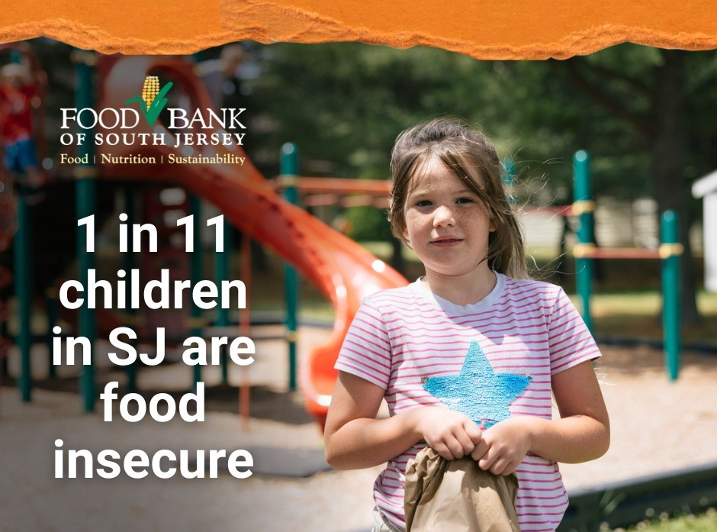
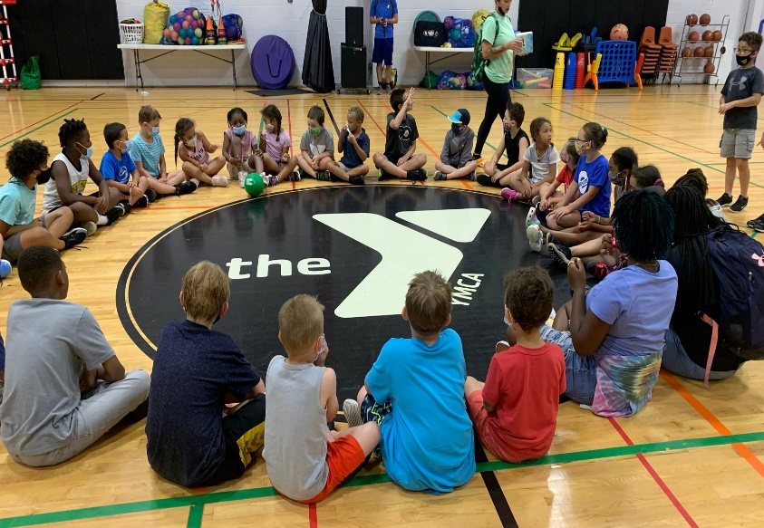

Why have a workplace campaign?
Although many of us would like to help others, giving a substantial amount all at once is not always possible.
Spreading your donation out over 20, 22, 24, or 26 pay periods (depending on your pay frequency) allows you to make a larger gift without ruining your budget. For example, $5.00 per pay x 26 pay periods equals a $130.00 annual gift…a little at a time adds up to so much!
The minimum donation for each designated gift is $26.00.
Charities must be certified 501(C)(3) registered charitable organizations in order to receive designated gifts.

Slide 7

Why give? Where do my contributions go?
If you do not designate your gift, it is allocated to 15 local programs within Gloucester County, overseen by our partner agencies. One gift helps many!
If you do desire to designate your gift, you may choose any of our Gloucester County partner agencies, or any charity within the United States, providing it is a certified 501(c)(3) registered charitable organization.
YOU can be part of the solution.
YOU have the opportunity to enrich a child’s life, feed a hungry family, assist a veteran, combat an illness, keep someone warm, support a wildlife habitat, rescue an animal, or provide someone with shelter.
THANK YOU for choosing to give!

Slide 8
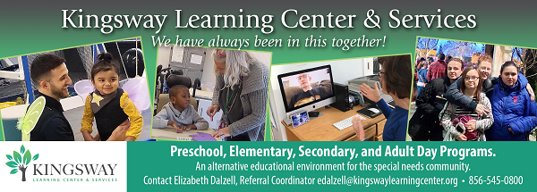

What are the benefits of participation?
When you contribute to the United Way campaign, you can be confident that:
Donating via payroll deduction minimizes administrative costs while maximizing your contribution (12.7% administrative cost)
With payroll deduction, you can manage your own philanthropy – you know when deductions start and that you can end them at any time
You can designate to as many charities as you wish, bearing in mind that each designation must be at least $26
Giving is cost-effective and effortless!

Slide 9
THE GOALS FOR 2024 ARE…
ASK YOUR COWORKERS TO GIVE – it is typical for people to avoid making a commitment unless they are specifically ASKED and are given enough information to make their decision – the #1 reason people do not give is because they were not asked. Suggest that they visit our online Campaign Toolkit which can be found at https://uwgcnj.org/campaign-toolkit/ where there is a wealth of information at their fingertips about what we do!
INCREASE PARTICIPATION – determine ways to reach out to all employees
INCREASE THE CAMPAIGN’S AWARENESS BY INCREASING VISIBILITY – share information about the campaign via posters throughout your workplace (contact us for more info about this!), email blasts, texts, and by holding employee group meetings, when possible

Slide 10
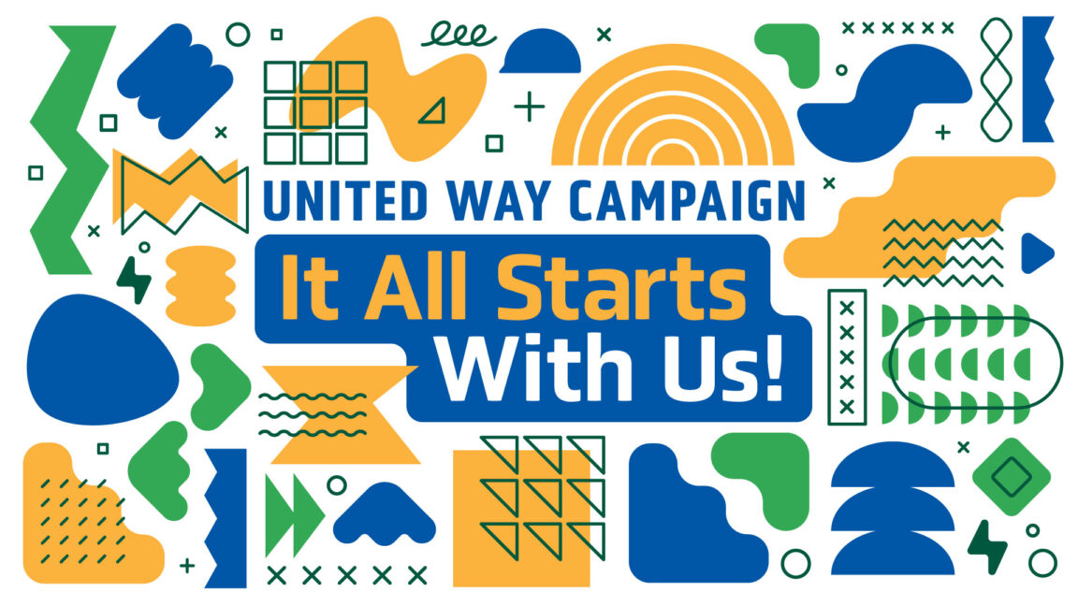
Important First Steps
Attend ECM (Employee Campaign Manager) Training…this forum typically is held each September in the UW office and lasts a couple of hours in the morning. New ideas are presented, successful techniques are reviewed, and there are many opportunities to brainstorm with your fellow ECMs. A continental breakfast is also offered.
Review last year’s campaign – what worked and what you would do differently
Seek campaign support from top management
There’s fun in numbers! Recruit a few coworkers who are eager to help
Plan for how long your campaign will last…one week? Two?
Develop a fun strategy that includes a short campaign kickoff (maybe during lunchtime!) with some light refreshments, and propose a theme, incentives or other activities

Slide 11
Do you and your coworkers want to help people in your community?
It’s easy! Here’s how…

Slide 12
ECM Plan of Action
1. Teamwork! Ask a couple of your coworkers to assist you…this will be your “committee”.
2. Ask senior management if they would publicly support the campaign via email blasts,
or thanking those who pledged via email or text.
3. Review the prior year’s campaign performance & calculate a winning strategy.
4. Be the “face” of United Way…hand deliver brochures to your coworkers, put
up posters around your workplace announcing the campaign, look on our website at
www.uwgcnj.org/campaign-toolkit/ for motivational posters & other materials!
5. Run the campaign:
  Personalize pledge forms with employee names, if possible
  Schedule dates for the campaign to begin and end
  Ask Donna Murphy, UWGC Campaign Director, to schedule a guest speaker for your kickoff date
  Make sure all employees have received UWGC Brochures and pledge forms
6. Report campaign results to Donna Murphy (see “Wrapping Up the Campaign”)
7. Report final results throughout your workplace and thank all who pledged via email
blast, text, and/or departmental meeting.
8. Don’t forget to say THANK YOU to all donors, committee members, and helpers!

Slide 13

Things to do during the Campaign…
Emphasize payroll deduction as the preferred method of giving…it’s the most cost-effective and easiest way to pledge.
“Asks” are more effective if done in person rather than sending an “ask” in an email or leaving a pile of pledge forms in a common area…these are typically ignored. Instead, speak about the campaign at staff meetings either live or virtual, and hand pledge forms to your coworkers personally.
Promote and educate! Many people do not realize that pledging just $3.00 per week (the price of a cup of coffee) becomes $156.00 given per year! Make sure all your coworkers know this.
Create awareness of the campaign using posters, fliers, and email blasts.
Share your campaign results throughout your workplace.
Track and report results.

Slide 14
Wrapping up the Campaign
Make a final request via email for all employees to fill out their pledge forms
Ensure the pledge forms are filled out completely, signed, and that the math is accurate…say THANK YOU to all those who pledge!
Collect pledge forms and any cash or checks (most pledges will be payroll deduction), total all the proceeds, collect Thanks for Giving tickets, put everything in an Employee Campaign Envelope (provided for you), and give to your Loaned Executive or call Campaign Director Donna Murphy to let her know that it’s ready for pick up (856.845.4303 x180).
Develop a formal thank you plan for all volunteers and donors…an email blast along with an invitation to donuts in the breakroom is one idea

Slide 15
And the most important “Best Practice” of all….
SAY “THANK YOU”!
Send a personal thank you to your campaign team & management.
Place Thank-You posters throughout facility (available from UWGC and can be found on our website www.uwgcnj.org/campaign-toolkit/ …please email lcheeseman@uwgcnj.org for more info – all posters can be personalized)
Publish a special Thank-You edition of Employee Newsletter.
Send Thank-You emails or text messages.
Always publicize winners of raffles, prizes, competitions, etc.

Slide 16


Many of our supporters have asked for more information concerning how their donations are spent supporting various programs at our partner agencies.
We heard you! On the following pages you will find examples of helpful and educational campaign materials for you to use as you run your campaign. All these and much more can be found on our website at uwgcnj.org/campaign-toolkit/

Slide 17
SUCCESS STORIES…
These are submitted by our partner agencies on their applications to UWGC for funds to support a specific program. This one was submitted by Center for Family Services to support their Mother/Child Residential program.

Slide 18
IMPACT STATEMENTS…
Partner agencies requesting funding from UWGC are asked to state how this funding will impact specific programs. These two statements are from Samaritan Healthcare & Hospice and Volunteers of America, Delaware Valley.

Slide 19

WHAT WILL YOUR PLEDGE PURCHASE?
In order to present more detailed information to potential donors, partner agencies are asked by UWGC to state what a specific donation would buy to assist their program. This one was submitted by Arc Gloucester’s Camp Sun ‘N Fun.

Slide 20

These are just 3 examples of the many helpful campaign tools you can use to enhance donors’ knowledge of what our partner agencies do. Find many more at our website:
uwgcnj.org/campaign-toolkit/

Slide 21
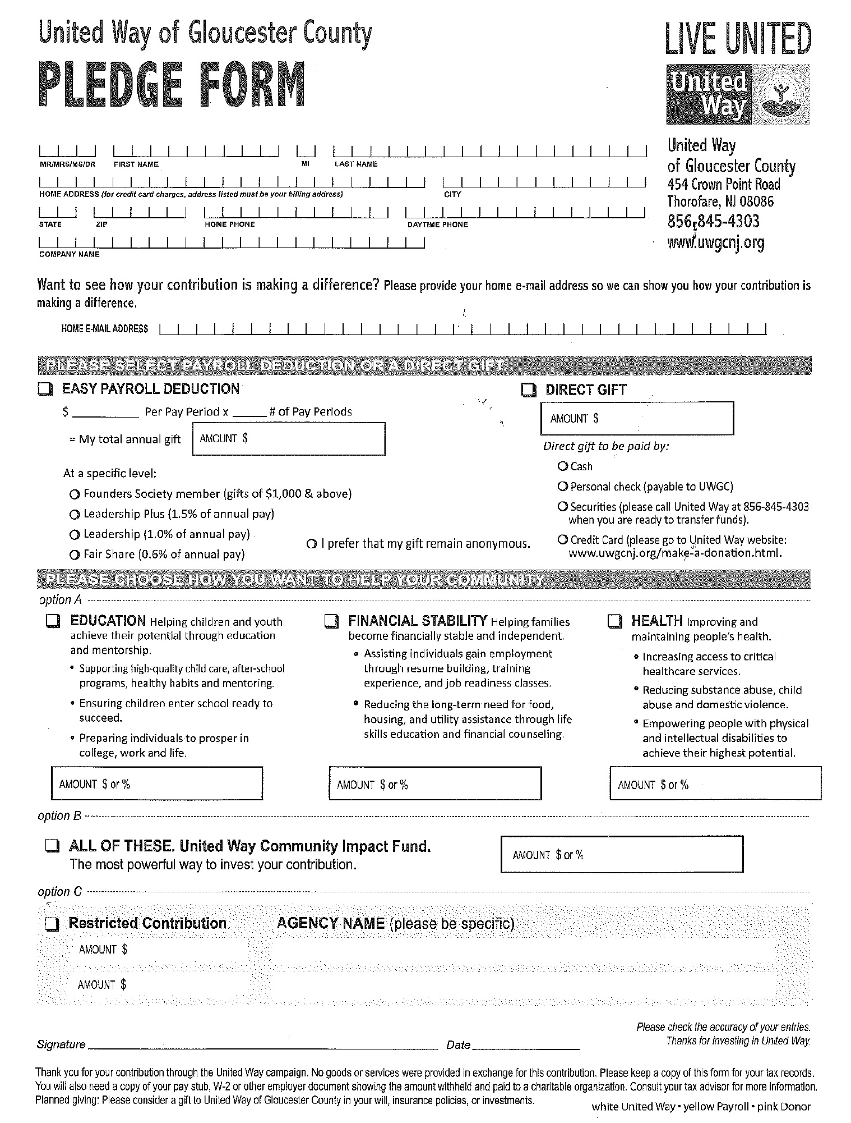
Campaign Pledge Form - Redesigned
(separate donor choice form not necessary with this)
This pledge form is in 3 parts:
* 1st page = white, United Way
copy
* 2nd page = yellow, Payroll copy
* 3rd page = pink, Donor copy
(for tax purposes)
Fill in complete information for name,
address, employer and phone
PLEASE provide email so we may add
you to our monthly newsletter
Determine manner to contribute
Verify pay periods
Compute total annual gift
PLEASE MAKE SURE TO SIGN FORM FOR
PAYROLL DEDUCTIONS
If making a gift via check – PLEASE
make check payable to UWGC
Determine how you want to help

Slide 22
Employee Campaign Report Envelope
(blue lettering – for UW accounts only)
Give
Advocate
Volunteer

Slide 24
Thanks for Giving Raffle Ticket

Slide 25
2024 Funding Awards (June 2024 – July 2025)

Slide 26
UWGC Brochure for Campaign 2024
Ask your Loaned Executive for an adequate supply of these for all of your coworkers, or call Donna Murphy
at 856.845.4303 x180

Slide 27


THE LIVE UNITED 365 SMALL BUSINESS CIRCLE
For only a dollar a day, or $365 a year, your business becomes
a member of the LIVE UNITED 365 Small Business Circle.
United Way of Gloucester County (UWGC) has created an
easy, affordable, and effective way for companies with
fewer than 35 employees to give back to their community.
Being a 365 Small Business Circle member aligns your
business with the strong LIVE UNITED brand, recognized
as one of the Top 10 most recognizable nonprofit brands
in the world. You will receive an exclusive LIVE UNITED
365 Small Business Circle decal to display and show your
customers your commitment to the community, plus you’ll
receive many other member benefits.
Current Members of the UWGC 365 Small Business Circle
Aquatic Artists
Bellia Print & Design
Best Buds
BonBon’s Parties & Events
Botto’s Italian Line Restaurant
Cepha Management
Ciaccia, CPA
Cipriani Remodeling Solutions
Clear Path by Cindy
Columbia Bank
Connolly Family Dentistry
Death of the Fox Brewing
DeSimone Construction Co., LLC
DeSimone Law Offices, LLC
Edward Jones / Jim Kelleher®
Franklin Bank
Research 1166 Federal Credit Union
Riggs Creative Group, LLC
Spartan Digital Solutions
Sweetsboro Pastry Shoppe
TD Bank
Telecorp, Inc.
Tim Skabo State Farm Agency
Tummy Tee, LLC
Urban Air Sicklerville
US Electrical Services
VisionLine Media
Ward, Shindle & Hall, Attorneys at Law
Your CBD Store of Gibbstown
Glassboro Rotary Club
Graham Communications
H.A. DeHart & Son
Heritage’s Dairy Stores
Ignite Business/Development Partners, LLC
Impressions Unlimited Printing Co., LLC
Lamb Realty
Lisa Carney Retail Agency, LLC
Mantua Coin-Op Laundromat
Maui Ice
Morris Graphics, Inc.
Mullica Hill Family Dentistry
Newfield National Bank
Parke Bank
PPLSI/LegalShield

Slide 28
The investment made to UWGC by our 365 Small Business Circle Participants provides funding for a number of Mini-Grants of up to $1,500 each for programs and agencies to conduct life-changing work in Gloucester County. Since 2015, this initiative has supported 107 programs and has raised over $129,000 to provide these services to Gloucester County residents. Mini-Grants are awarded in the fall of the calendar year. The following organizations received Mini-Grants for Year 2023:
A Champion’s Heart
Angels Community Outreach
BookSmiles
Boys & Girls Club of Gloucester County
Center for Independent Living of South Jersey
Clarifi Consumer Credit Counseling Services of Delaware Valley
Emmanuel Cancer Foundation
The FAF Coalition
Greater Woodbury Cooperative Ministries, Inc.
Gloucester County Habitat for Humanity
The Lighthouse Community Center
Newfield Terrace Community Action Organization
Partners in Learning
Paulsboro Midget Football Organization
Pegasus Education Foundation
People for People Foundation of Gloucester County, Inc.
Professional Trainers Advancing Humanity Initiative, Inc. (P.T.A.H.)
SHADOW Equestrian, Inc.
South Jersey Dream Center
South Jersey Robotics
Wheels of Change
Your Place At The Table
For more information about the 365 Live United Small Business Circle, please contact Donna Murphy at 856.845.4303 x 180, or donnamurphy@uwgcnj.org. For a complete description of each program, please visit our website uwgcnj.org/campaign/small-business-program/.

Slide 29
Posters! Call 856.845.4303 x 100 and we can personalize these any way you like!
Here are some examples…more can be found at uwgcnj.org/campaign toolkit

Slide 30

THANK YOU!
For giving!
For your support and enthusiasm!
For inspiring others!

